Slide 1
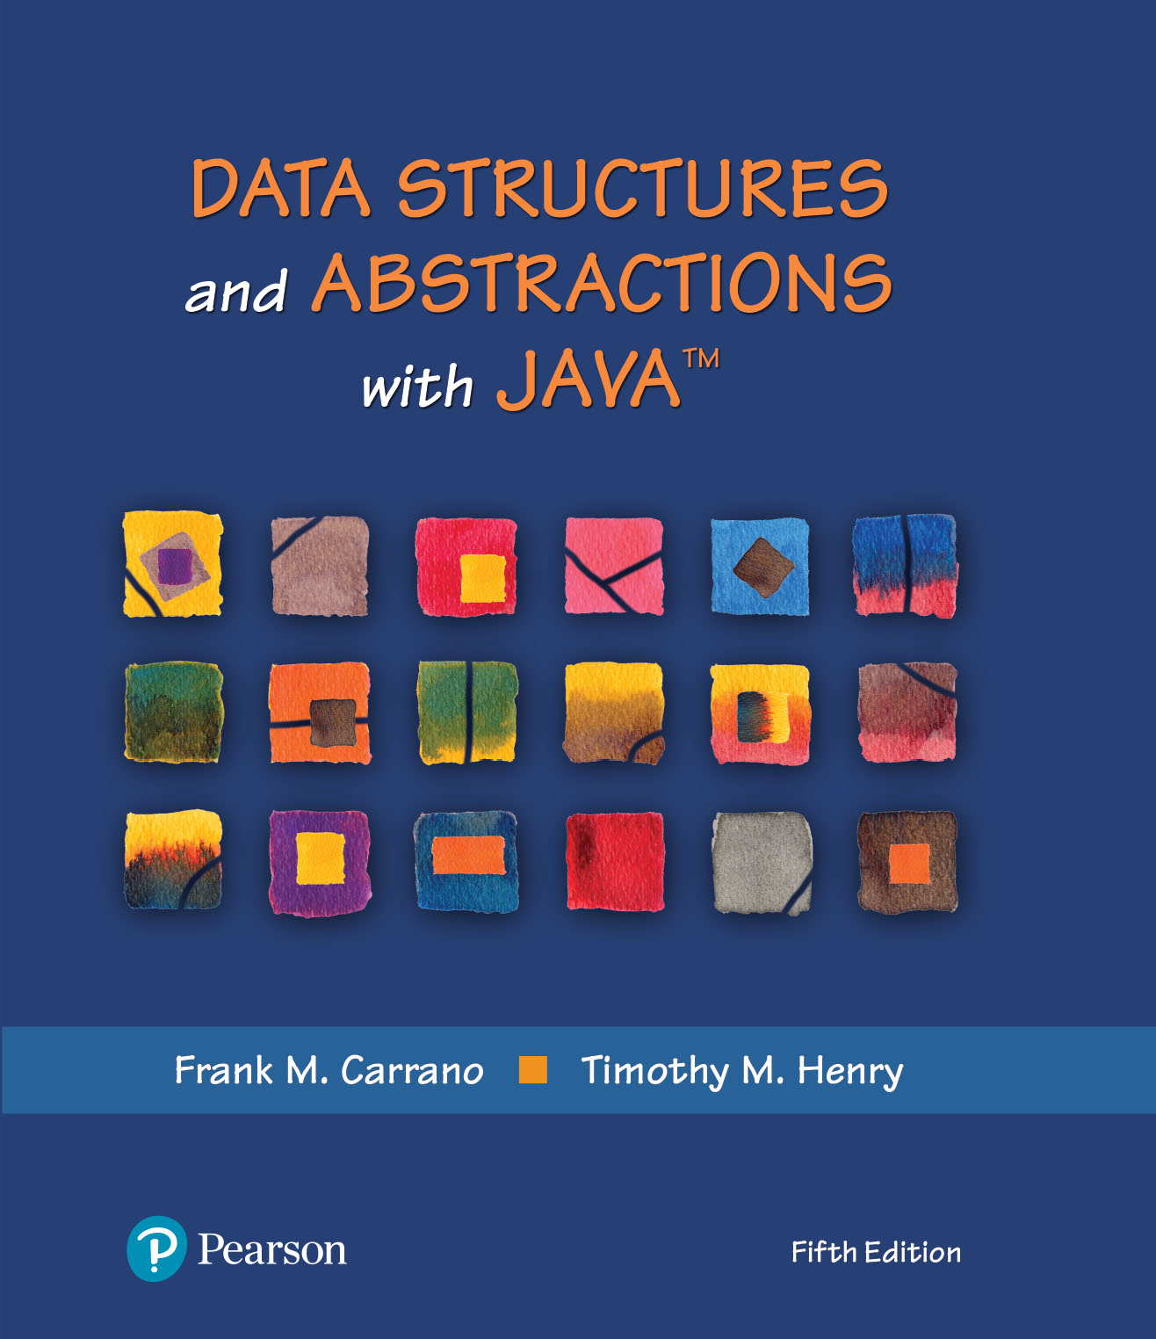
Data Structures and Abstractions with Java™
Module 3
5th Edition
Generics

Slide 2
Topics
Generic Data Types
Content can be found in Data Structures and Abstraction with Java by Carrano & Henry

Slide 3
Generic Data Types
Enable you to write a placeholder instead of an actual class type
The placeholder is
A generic data type
A type parameter
You define a generic class
Client chooses data type of the objects in collection.

Slide 4
Generic Types
A generic type is a class or interface that introduces a family of parameterized types by declaring a formal type parameter list (a comma-separated list of type parameter names between angle brackets). This syntax is expressed as follows:
class identifier<formal_type_parameter_list> {} interface identifier<formal_type_parameter_list> {}
For example, List<E> is a generic type, where List is an interface and type parameter E identifies the list's element type.

Slide 5
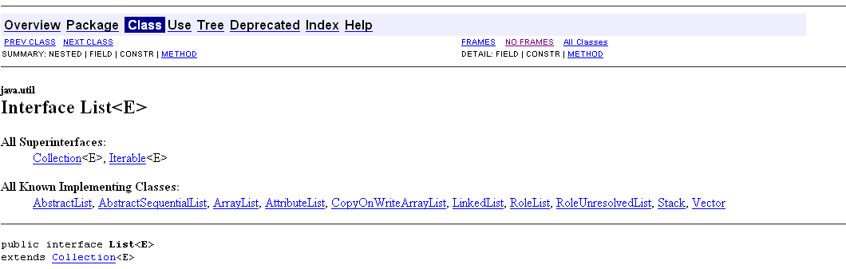
List Interface
An ordered collection (also known as a sequence). The user of this interface has precise control over where in the list each element is inserted. The user can access elements by their integer index (position in the list), and search for elements in the list.
Unlike sets, lists typically allow duplicate elements. More formally, lists typically allow pairs of elements e1 and e2 such that e1.equals(e2), and they typically allow multiple null elements if they allow null elements at all. It is not inconceivable that someone might wish to implement a list that prohibits duplicates, by throwing runtime exceptions when the user attempts to insert them, but we expect this usage to be rare

Slide 6
Standard Type Variable Names
Type Variable | Name Meaning
E | Element type in a collection
K | Key type in a map
V | Value type in a map
T | General type
S, U | Additional general types

Slide 7
Generic Classes
Classes that can be used with many different types
In Java, achieved with type parameters or with inheritance
Type parameter example: Java's ArrayList (e.g. ArrayList<String>)
Inheritance example: user defined LinkedGroup can store objects of any class, all classes inherit from Object
public class LinkedGroup { ... private class Node { public Object data; public Node next; } }

Slide 8
Generic Classes
Generic class: declared with one or more type parameters
A type parameter for ArrayList denotes the element type:
public class ArrayList<E>
{
public ArrayList() { . . . }
public void add(E element) { . . . }
. . .
}

Slide 9
Type Parameters
Can be instantiated with class or interface type:
ArrayList<BankAccount> // BankAccount is a class
ArrayList<Measurable> / / Measurable is a interface
Cannot use a primitive type as a type variable:
ArrayList<double>
Use corresponding wrapper class instead:
ArrayList<Double>

Slide 10
Type Parameters
Supplied type replaces type variable in class interface
Example: add in ArrayList<BankAccount> has type variable E replaced with BankAccount:
public void add(E element) { . . . }
becomes:
public void add(BankAccount element){ . . . }
Contrast with user defined LinkedGroup.add():
public void add(Object element)
How is the add(BankAccount element) method definition
for an ArrayList better than the add(Object element) definition for the LinkedGroup?
To use any of the methods of the class/object stored in LinkedGroup, element would have to be cast into the correct object.

Slide 11
Type Parameters Increase Safety
Type parameters make generic code safer and easier to read
Impossible to add a String into an ArrayList<BankAccount>
Can add a String into a LinkedGroup intended to hold bank accounts
ArrayList<BankAccount> accounts1 =
new ArrayList<BankAccount>();
LinkedGroup accounts2 = new LinkedGroup();
// Should hold BankAccount objects
accounts1.add("my savings");
// Compile-time error
accounts2.add("my savings");
// No error detected at compile time
. . . BankAccount account = (BankAccount)accounts2.BankAccountmethod();
// Run-time error

Slide 12
Interface
/**
An interface for pairs of objects.
*/
public interface Pairable<T>
{
public T getFirst();
public T getSecond();
public void changeOrder();
} // end Pairable
LISTING JI1-1 The interface Pairable

Slide 13
Example Generic Class (Part 1)
/** A class of ordered pairs of objects having the same data type. */
public class OrderedPair<T> implements Pairable<T>
{
private T first, second;
public OrderedPair(T firstItem, T secondItem) // NOTE: no <T> after constructor name
{
first = firstItem;
second = secondItem;
} // end constructor
/** Returns the first object in this pair. */
public T getFirst()
{
return first;
} // end getFirst
LISTING JI1-2 The class OrderedPair

Slide 14
Example Generic Class (Part 2)
/** Returns the second object in this pair. */
public T getSecond()
{
return second;
} // end getSecond
/** Returns a string representation of this pair. */
public String toString()
{
return "(" + first + ", " + second + ")";
} // end toString
/** Interchanges the objects in this pair. */
public void changeOrder()
{
T temp = first;
first = second;
second = temp;
} // changeOrder
} // end OrderedPair
LISTING JI1-2 The class OrderedPair

Slide 15
The Interface Comparable
Consider the method compareTo for class String
if s and t are strings, s.compareTo(t) is
Negative if s comes before t
Zero if s and t are equal
Positive if s comes after t

Slide 16
The Interface Comparable
By invoking compareTo, you compare two objects of the class T.
LISTING JI5-3 The interface java.lang.Comparable
public interface Comparable<T>
{
public int compareTo(T other);
} // end Comparable

Slide 17
The Interface Comparable
Create a class Circle, define compareTo
public class Circle implements Comparable<Circle>, Measurable
{
private double radius;
// Definitions of constructors and methods are here.
// . . .
public int compareTo(Circle other)
{
int result;
if (this.equals(other))
result = 0;
else if (radius < other.radius)
result = -1;
else
result = 1;
return result;
} // compareTo
} // end Circle

Slide 18
Generic Methods
Generic method: method with a type variable
Can be defined inside non-generic classes
Example: Want to declare a method that can print an array of any type:
public class ArrayUtil
{
/**
Prints all elements in an array.
@param a the array to print
*/
public static <T> void print(T[] a)
{
. . .
}
. . .
}

Slide 19
Generic Methods
Often easier to see how to implement a generic method by starting with a concrete example; e.g. print the elements in an array of strings: public class ArrayUtil
{
public static void print(String[] a) { for (String e : a) System.out.print(e + " "); System.out.println();
}
. . . }

Slide 20
Generic Methods
In order to make the method into a generic method:
Replace String with a type parameter, say E, to denote the element type
Supply the type parameters between the method's modifiers and return type
public static <E> void print(E[] a)
{
for (E e : a)
System.out.print(e + " ");
System.out.println();
}

Slide 21
Generic Methods
When calling a generic method, you need not instantiate the type variables:
Rectangle[] rectangles = . . .; ArrayUtil.print(rectangles);
The compiler deduces that E is Rectangle
You can also define generic methods that are not static
You can even have generic methods in generic classes
Cannot replace type variables with primitive types e.g.: cannot use the generic print method to print an array of type int[]

Slide 22
Generic Methods
public class Example
{
public static <T> void displayArray(T[] anArray)
{
for (T arrayEntry : anArray)
{
System.out.print(arrayEntry);
System.out.print(' ');
} // end for
System.out.println();
} // end displayArray
public static void main(String args[])
{
String[] stringArray = {"apple", "banana", "carrot", "dandelion"};
System.out.print("stringArray contains ");
displayArray(stringArray);
Character[] characterArray = {'a', 'b', 'c', 'd'};
System.out.print("characterArray contains ");
displayArray(characterArray);
} // end main
} // end Example
Listing JI5-2 An example of a generic method

Slide 23
Bounded Type Parameters
Consider this simple class of squares:
public class Square<T>
{
private T side;
public Square(T initialSide)
{
side = initialSide;
} // end constructor
public T getSide()
{
return side;
} // end getSide
} // end Square
Different types of square objects possible.
Square<Integer> intSquare = new Square<>(5);
Square<Double> realSquare = new Square<>(2.1);
Square<String> stringSquare= new Square<>("25");

Slide 24
Bounded Type Parameters
Imagine that we want to write a static method that returns the smallest object in an array. Suppose that we wrote our method shown here:
public MyClass
{
// First draft and INCORRECT:
public static <T> T arrayMinimum(T[] anArray)
{
T minimum = anArray[0];
for (T arrayEntry : anArray)
{
if (arrayEntry.compareTo(minimum) < 0)
minimum = arrayEntry;
} // end for
return minimum;
} // end arrayMinimum
} // end MyClass

Slide 25
Bounded Type Parameters
Header really should be as shown
public MyClass
{
public static <T extends Comparable<T>> T arrayMinimum(T[] anArray)
{
T minimum = anArray[0];
for (T arrayEntry : anArray)
{
if (arrayEntry.compareTo(minimum) < 0)
minimum = arrayEntry;
} // end for
return minimum;
} // end arrayMinimum
// . . .
} // end MyClass

Slide 26
Wildcards
Question mark, ?, is used to represent an unknown class type
Referred to as a wildcard
Consider following method and objects
public static void displayPair(OrderedPair<?> pair)
{
System.out.println(pair);
} // end displayPair
OrderedPair<String> aPair = new OrderedPair<>("apple", "banana");
OrderedPair<Integer> anotherPair = new OrderedPair<>(1, 2);
Method displayPair will accept as an argument a pair of objects whose data type is any one class
displayPair(aPair);
displayPair(anotherPair);

Slide 27
Bounded Wildcards
<<interface>> Comparable<T>
+compareTo(other: T): integer
Widget
+compareTo(other: Widget): integer
Gadget
FIGURE J5-1 The class Gadget is derived from the class Widget, which implements the interface Comparable

Slide 28
Type Erasure
The virtual machine erases type parameters, replacing them with their bounds or Objects
For example, generic class Pair<T, S> turns into the following raw class:
public class Pair {
private Object first; private Object second;
public Pair(Object firstElement, Object secondElement) { first = firstElement; second = secondElement; } public Object getFirst() { return first; } public Object getSecond() { return second; } }

Slide 29
Type Erasure
Same process is applied to generic methods:
public static Comparable min(Comparable[] a)
{
Comparable smallest = a[0];
for (int i = 1; i < a.length; i++)
if (a[i].compareTo(smallest) < 0) smallest = a[i];
return smallest;
}

Slide 30
Type Erasure
Knowing about raw types helps you understand limitations of Java generics
For example, trying to fill an array with copies of default objects would be wrong:
public static <E> void fillWithDefaults(E[] a)
{
for (int i = 0; i < a.length; i++)
a[i] = new E();
}
Type erasure yields:
public static void fillWithDefaults(Object[] a)
{
for (int i = 0; i < a.length; i++)
a[i] = new Object(); // Not useful
}

Slide 31
Type Erasure
To solve this particular problem, you can supply a default value:
public static <E> void fillWithDefaults(E[] a,
E defaultValue)
{
for (int i = 0; i < a.length; i++)
a[i] = defaultValue;
}
This would have already been constructed

Slide 32
Type Erasure
You cannot construct an array of a generic type:
public class Group<E>
{
private E[] elements;
. . .
public Group()
{
elements = new E[MAX_SIZE]; // Error, would construct Object objects
}
}
How is this different?
public static <E> void print(E[] a)
{
for (E e : a)
System.out.print(e + " ");
System.out.println();
}
This array has already been
constructed

Slide 33
Type Erasure
One remedy is to use an array list instead:
public class Group<E>
{
private ArrayList<E> elements;
. . .
public Group()
{
elements = new ArrayList<E>(); // Ok
}
}

Slide 34
More Than One Generic Type
public class OrderedPair<T> implements Pairable<T>
{
private T first, second;
// The constructor and the methods
// getFirst, getSecond, toString, and changeOrder are here.
// . . .
} // end OrderedPair
Recall the class OrderedPair in Listing JI1-2 of Java Interlude 1

Slide 35
More Than One Generic Type
Possible to define more than one generic type within a class definition
Write identifiers, separated by commas, within angle brackets after class’s name
Each represents actual data type specified by the client when it instantiates object of the class

Slide 36
More Than One Generic Type
public class Pair<S, T>
{
private S first;
private T second;
public Pair(S firstItem, T secondItem)
{
first = firstItem;
second = secondItem;
} // end constructor
public String toString()
{
return "(" + first + ", " + second + ")";
} // end toString
} // end Pair
LISTING JI8-1 The class Pair

Slide 37
Using the class Pair
Name joe = new Name("Joe", "Java");
String joePhone = "(401) 555-1234";
Pair<Name, String> joeEntry = new Pair<>(joe, joePhone);
System.out.println(joeEntry);

Slide 38
Generic Array-Based Data Structures
Any type of node could be stored in the structure
Certain considerations must be followed in the design of the structure
The client application specifies the type of nodes that will be stored in the structure
The generic features of Java are used in the structure’s generic implementation

Slide 39
Design Considerations for Generic Data Structures
The node/data element definition and the data structure are coded as two separate classes
The data structure cannot mention the names of the data fields that make up a node/data element. Generic data structures don’t care what is being collected, only needs to know how insert, delete, fetch and update the collection
If the structure is going to be encapsulated, a method to perform a deep copy of a node/data element must be coded in the node/data element definition class

Slide 40
Design Considerations for Generic Data Structures
If the structure is going to be accessed in the key field mode, a method to determine if a given key is equal to the key of a node/data structure must be coded in the node/data structure definition class (possibly use Comparable or Comparator)
The data structure code cannot mention the name of the node/data element class
The data structure class cannot mention the key field’s type

